Slide 1
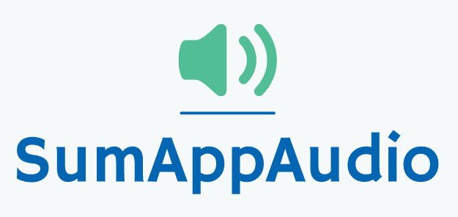
Fourth checkpoint
Group 4
Marco Carfora
Daniele Calisi
Francesco Bovi

Slide 2



Dyslexic students problems
During the last years the awareness on the dyslexia is increased. Indeed, it has been registered a raise of students with certified dyslexia (250.000 cases in Italy); from 0.7% in 2010 to 3.2% in 2018, on the total number of students.
Difficulties in reading and comprehending text
Don’t have a way to easily grasp the concepts, making the learning slow
Struggle to autonomously review school subjects

Slide 3



Our solution
Sum-AppAudio is a digital platform based on a student-to-student model to support the study of students with dyslexia. The core of the App are the recorded files that every student can upload to summarise subject topics or book chapters.
Uploads recordings
Listens recordings
NON-DYSLEXIC STUDENT
Gives feedbacks
DYSLEXIC STUDENT
Certifies recordings
TUTOR

Slide 4
Customers and Market size
Dyslexic students in Italy:
2% of primary schools students = 56.000; 5.6% of middle schools students = 90.000; 4.7% of high schools students = 122.000;
Non dyslexic students in Italy
Schools and pedagogical associations
Support teachers/tutors
Students in the world
TAM
3 Bln €
SAM
0.8% of TAM
Students in Italy
SOM
1,7% of SAM
Students in Rome (middle and high school) with a dyslexic in class
EARLY ADOPTERS

Slide 5

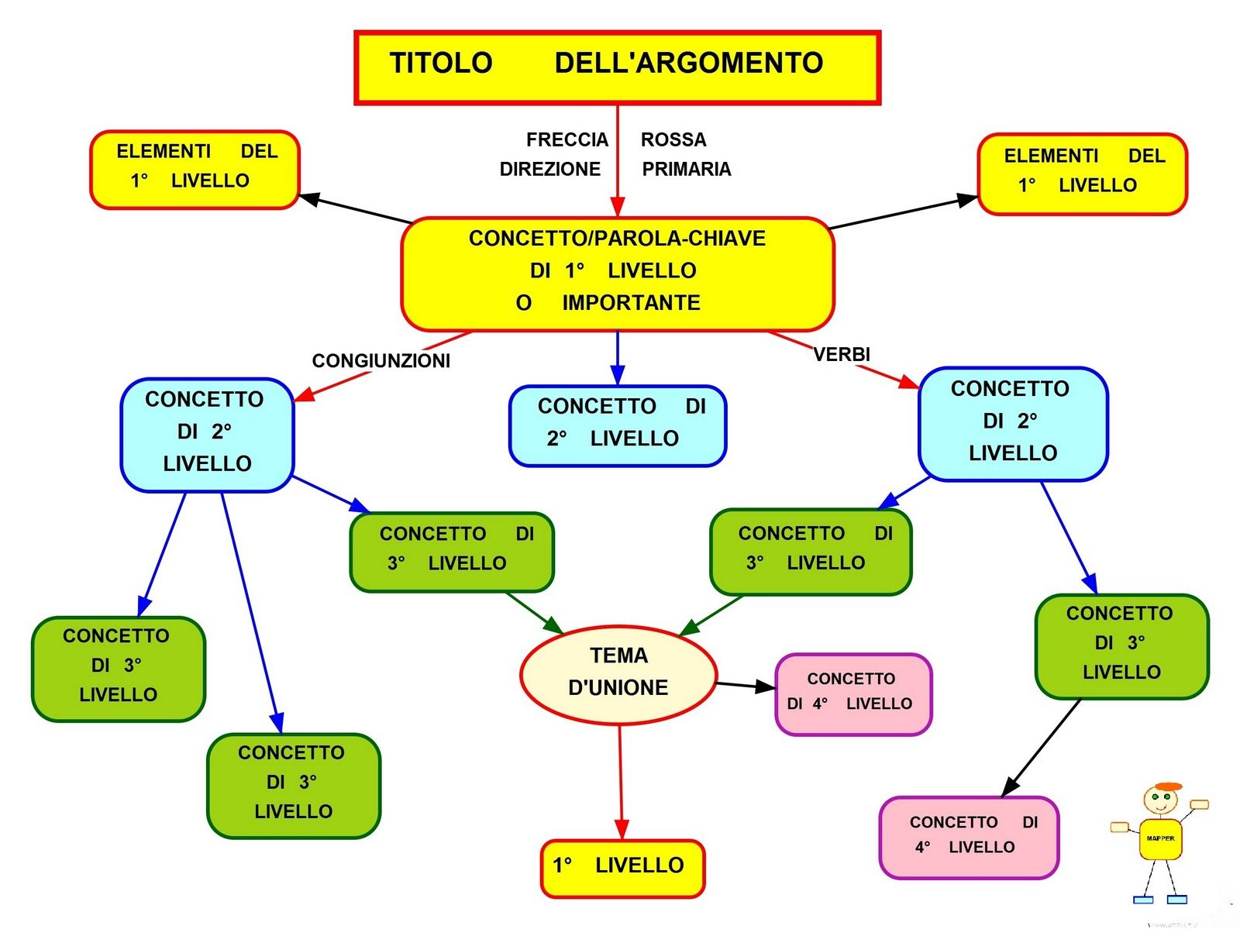




COMPETITORS ANALYSIS
Student-to-student system
Concept maps
Ad hoc Textbooks
Voice synthesizers
Ad hoc audio for dyslexic students

Slide 6
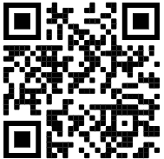
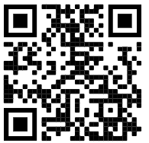
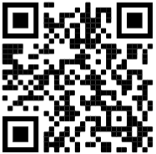
Assumptions validation: HOW
Method | Addressed to | Answers
Student’s Questionnaire | Scholars and ex-students, dyslexic and not. | 132
Tutor’s Questionnaire | Tutors and supporting teacher | 30
Economic Questionnaire | Scholars and ex-students, dyslexic and not | 47
MVP (Audio samples for dyslexic students) | Dyslexic students | 38
Distributed to: our contacts, facebook groups about dyslexia and tutoring.

Slide 7
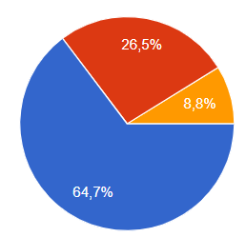
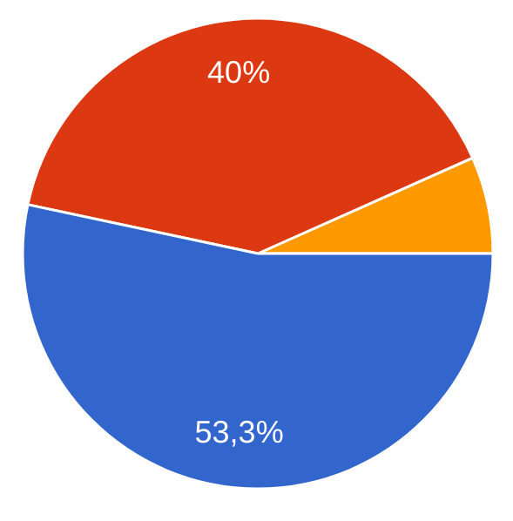
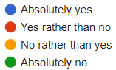
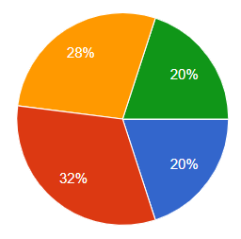
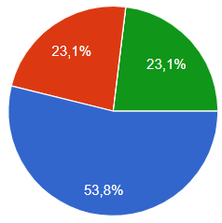
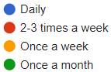
Validation results (1/3)
UPLOADING (Non-Dyslexic Students)
LISTENING (Dyslexic Students)
Availability to upload recordings
Uploading frequency
Utility of listening students recordings
Listening frequency

Slide 8
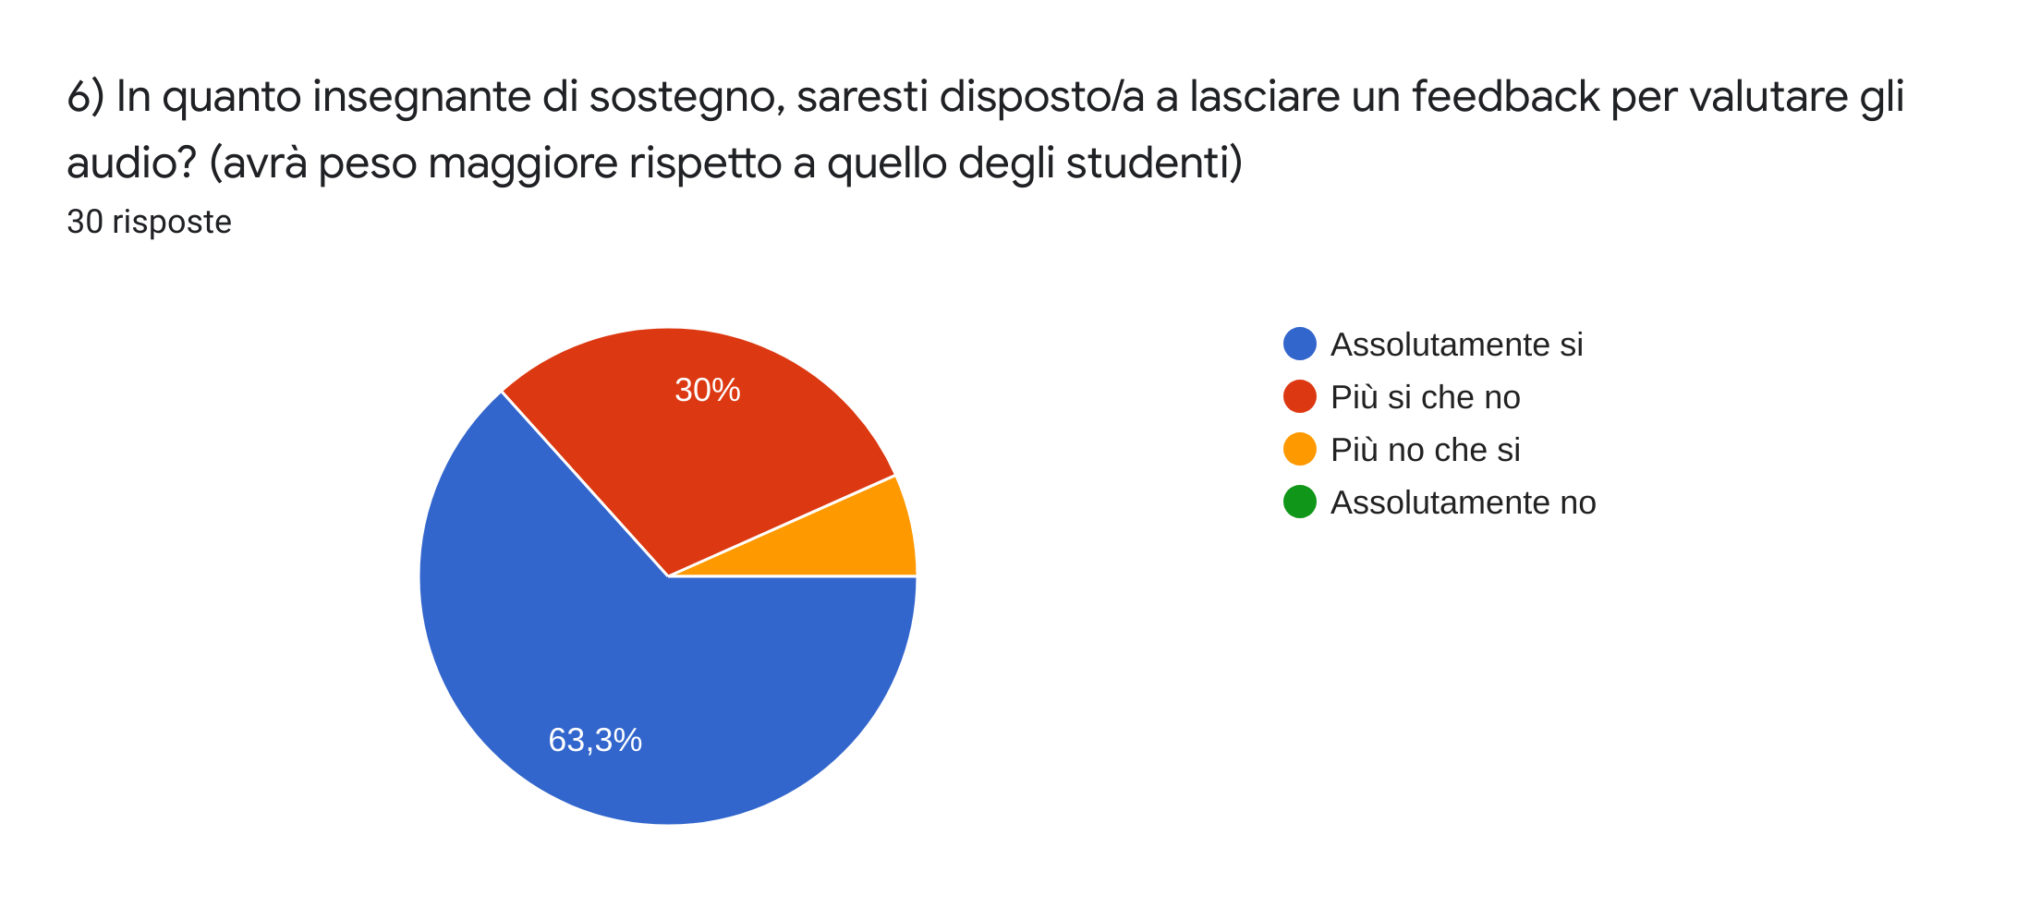
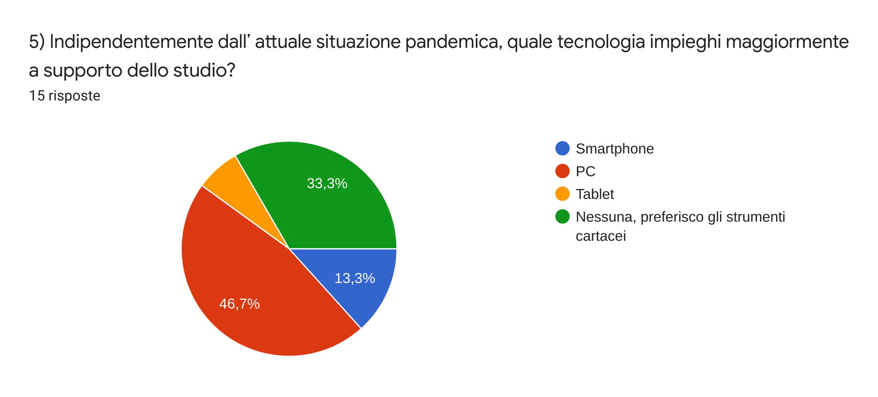
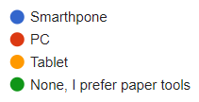
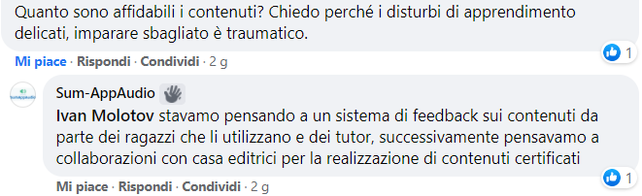
Validation results (2/3)
TECHNOLOGY (Everyone)
CERTIFYING (Tutors)
The application should be developed both for PC and smartphone, not only on the latter as we initially thought.
Electronic devices used to support study
Availability to certify recordings

Slide 9
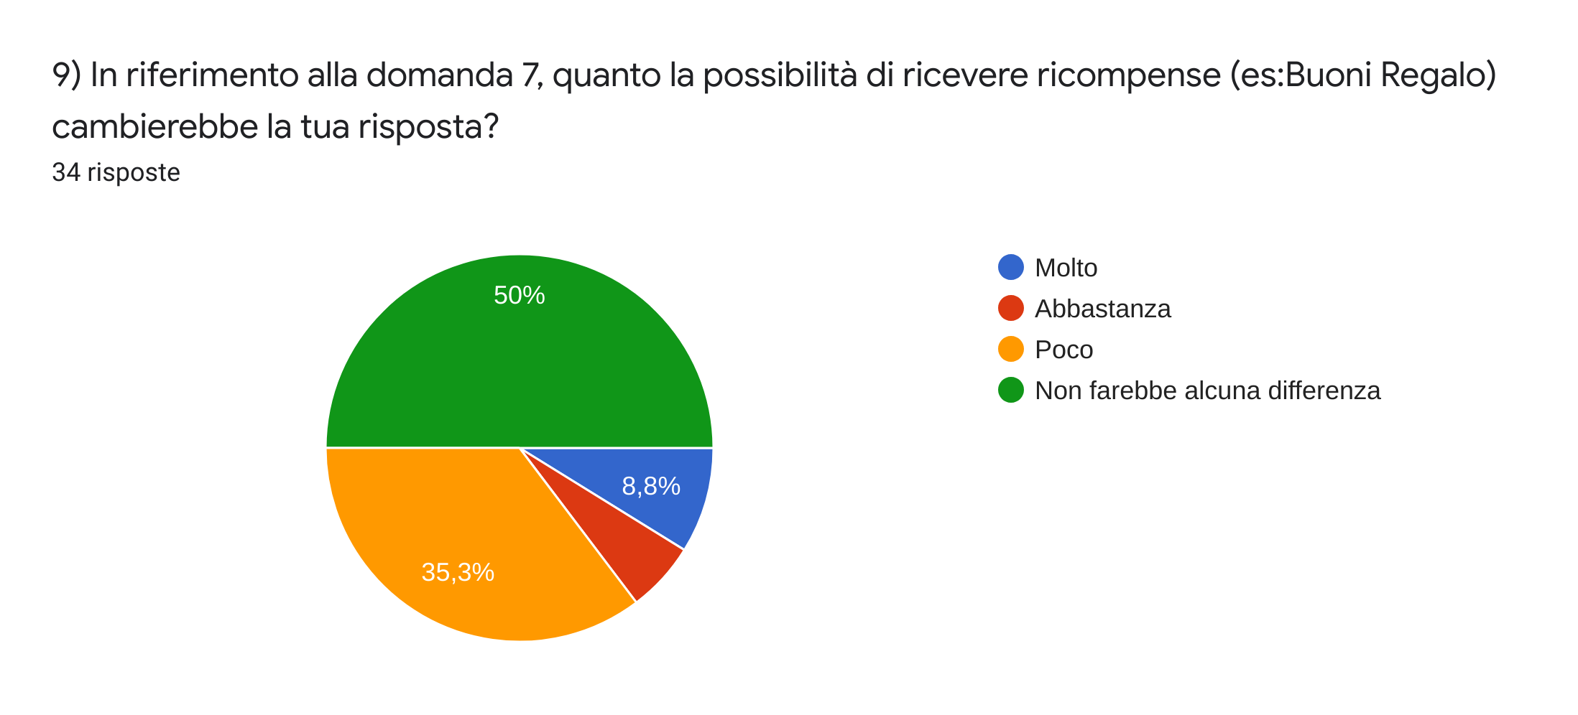
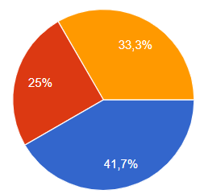
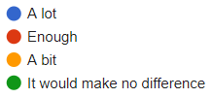
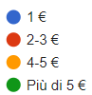
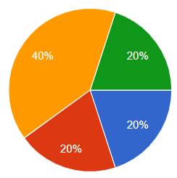
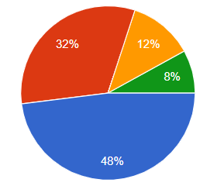
Validation results (3/3)
ECONOMIC ASSUMPTIONS (Students)
Usefulness of gift cards to incentivize uploadings
Availability to donate
Amount that customers would pay to purchase the App
Preference w.r.t. free App with digital banners

Slide 10
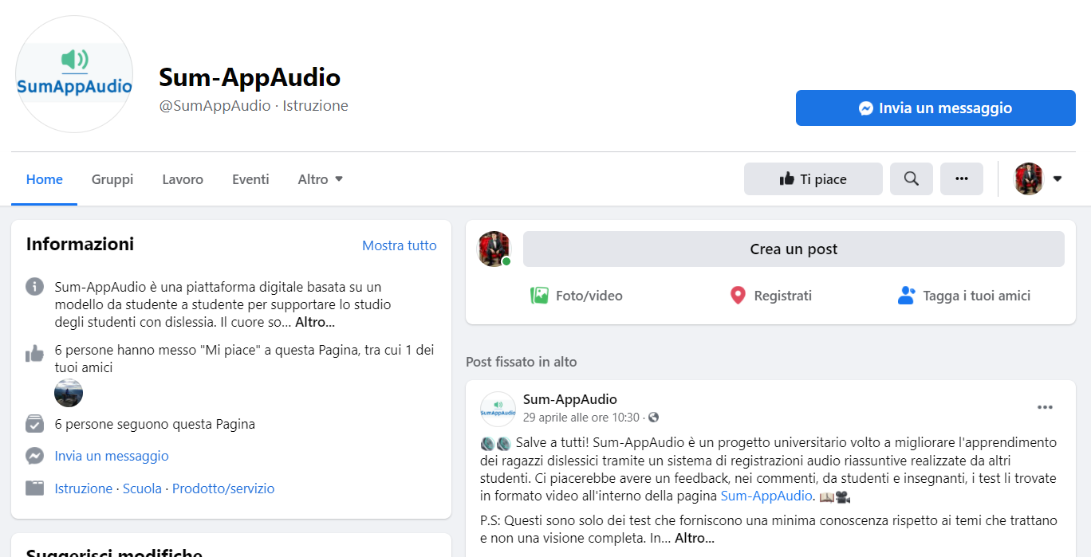

Assumptions validation: MVP
Also shared on a Landing Page to extend the audience
USEFULNESS OF THE AUDIO SYSTEM
(Dyslexic students)
We have contacted some dyslexic students and provided them a few audio samples; they listened the recordings and evaluated the quality, thus to give us a feedback
Audio samples:
Respiratory System
Assyrians
Athens
Sparta

Slide 11
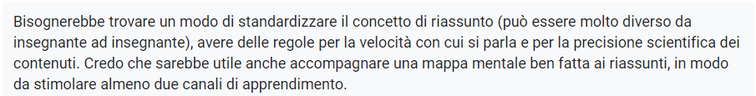
Validation results (MVP)
Positive feedbacks: 88%
COMMENTS
Suggestions:
Guidelines to improve audio content quality;
Concept maps attached can help to understand better recordings;
Highlight the nickname of the content creator;
It can be useful also for other disorders (blindness, loss of concentration);

Slide 12
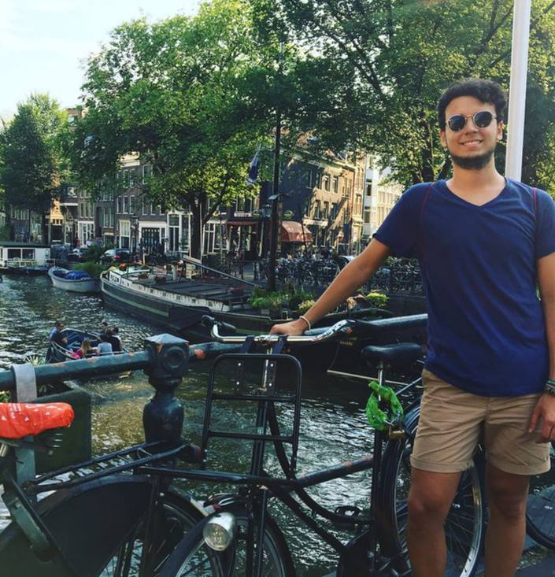
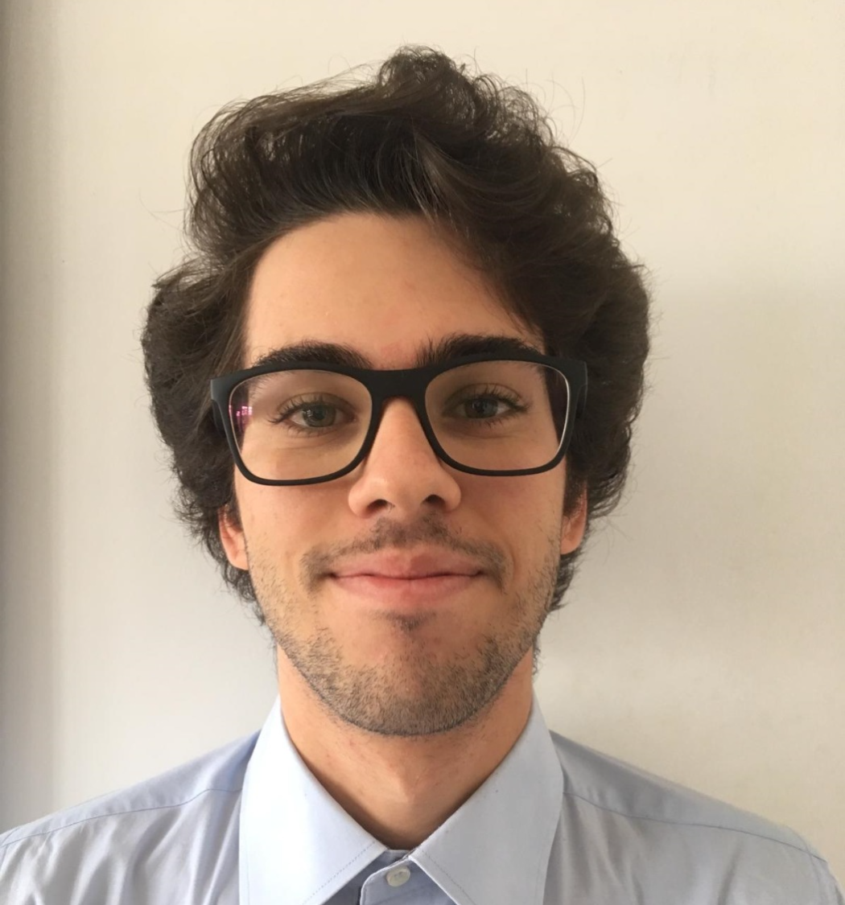
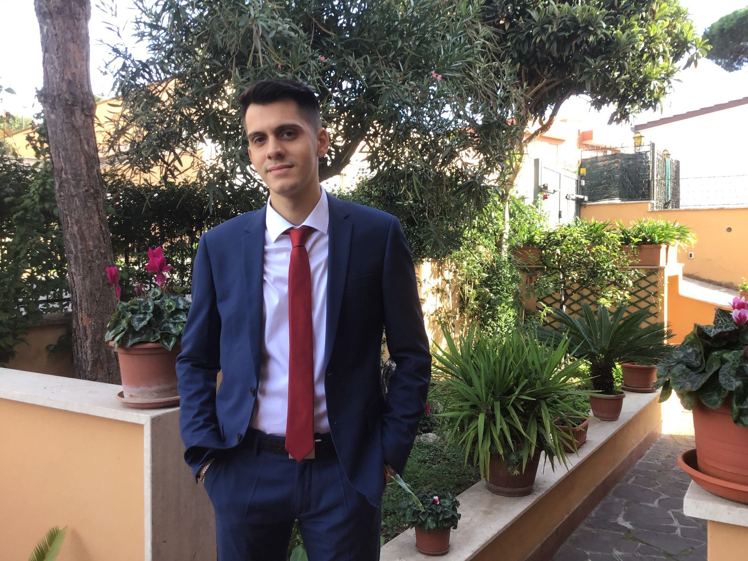
Our Team
MARCO CARFORA
DANIELE CALISI
FRANCESCO BOVI
Web design frontend
Mobile developer
Neural networks
Web design backend
Data management
Machine Learning experience
Software Developer;
Cybersecurity;
AI experience;

Slide 13
THANK
YOU!

Slide 14
Business concept
During the last years the awareness on the dyslexia is increased. Indeed, it has been registered a raise of students with certified dyslexia (177.000 cases in Italy), from 0.7% in 2010 to 3.2% in 2018 but the number is probably higher.
Students affected by dyslexia have difficulties in reading a text and troubles copying from the blackboard. They don’t have a way to easily grasp the concepts and to make the comprehension faster, indeed they usually need external help, like a tutor.
Sum-AppAudio is a digital platform based on a student-to-student model to support the study of students with dyslexia. The core of the App are the recorded files that every student can upload to summarise subject topics or book chapters. The system is designed ad hoc to overcome the difficulties that students with dyslexia have to face but also other students can enjoy the service.

Slide 15
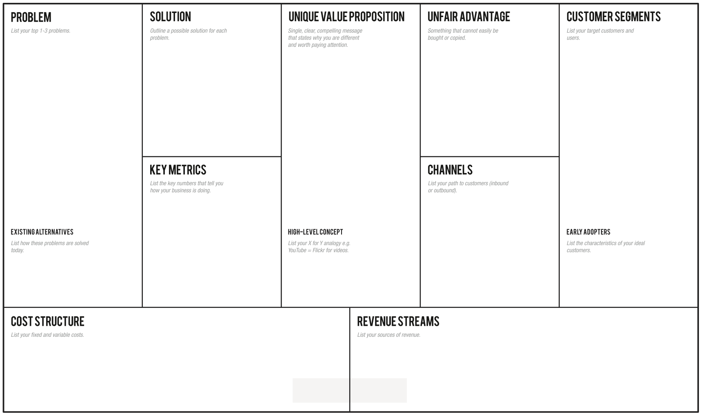
-Students with dyslexia have difficulties in reading and comprehending a text:
-They don’t have a way to easily grasp the concepts, making the learning slow.
-They need an easy way to autonomously review school subjects, indeed they usually ask for external help
Through the app the students can learn in an easier and efficient way, avoiding tiring readings, relying on recordings from a huge collection built thanks to a lot of students' support
Overcome your reading and learning difficulties, enjoy a student-to-student model whose core are the recorded files that every student can upload to summarise subject topics or book chapters for students with dyslexia.
-Students with dyslexia problems (2% from primary schools, 5.6% from middle schools, 4.7% from high schools).
-Schools and pedagogical associations -Support teachers.
-Every student who wants to help other ones.
-Number of produced and listened recordings (monthly).
-Content quality trends thanks to feedback system.
-How many results appear for a single topic.
-How many people use the app regularly (rate of accesses)
-Flyers distribution in front of selected schools and associations of this sector.
-A social page dealing with dyslexia problem.
-Meetings in school where we present our project to students.
- Selected classes with a dyslexic student in Rome schools, so classmates can help each other -Tutors / Support teachers
Skuola.net, ad hoc textbooks, Youtube, voice synthesizers, tutors, concept maps
Sum-AppAudio = Spotify for school summaries.
-Server/database maintenance;
-Channels’ cost;
-Gift cards at a later time
- Banner advertisements;
- Freemium App
- Partnerships with schools/associations;
- Partnerships with publishing companies to certify their content;

